Slide 1
Big Data Week 12 Machine Learning at Scale
Professor Arturo Castellanos, PhD
Assistant Professor – William & Mary
Big Data - MSBA

Slide 2
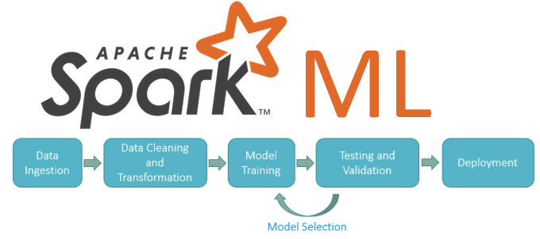

Jupyter Notebook

Slide 3
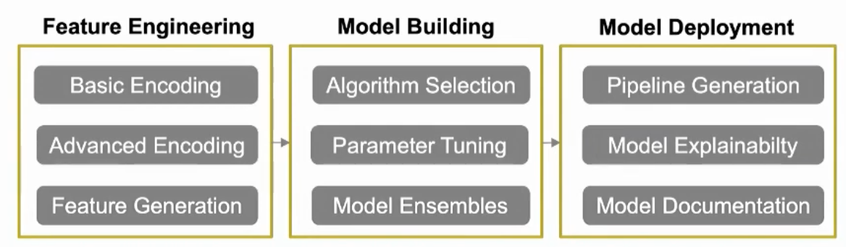

Slide 4
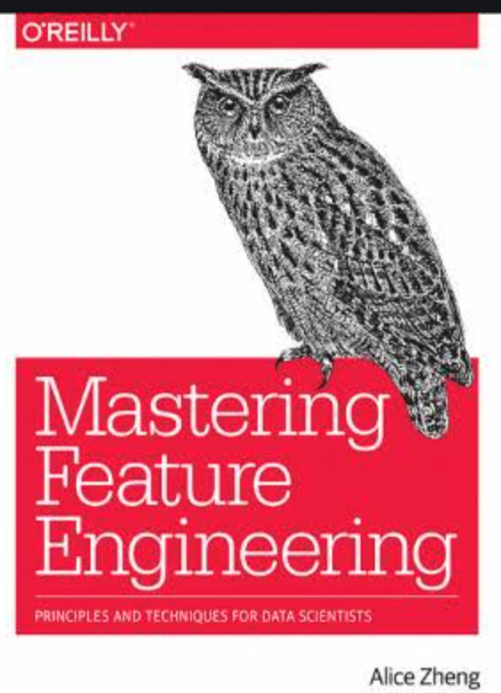
Feature engineering
Problem: Augment feature space
Solution: Feature engineering (SVD, PCA, Interactions, Clustering)
Log transformation log(x): the larger the x, the lower the log(x) increments. Useful to smooth long-tailed data.
Scaling:
MinMax scaling: squeezes values into a range of [0,1] [sklearn → MinMaxScaler()]
Standard Z-scaling: after standardization, a feature has mean 0 and variance of 1. [sklearn→ scale()]
Interaction features: créate feature combinations (x₁,x₂)->[x₁,x₂, x₁x₂, x₁², x₂²) [sklearn –polynomial features]

Slide 5
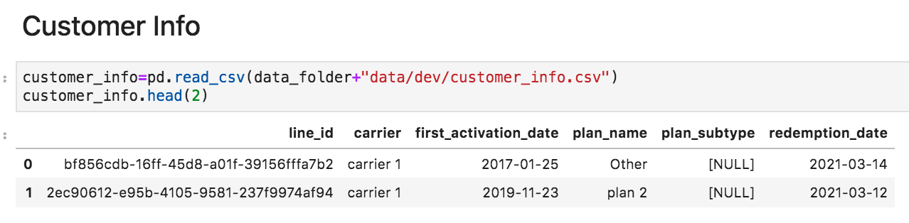
Feature engineering: Categorical Encoding
Problem: Many ML algorithms work better with numerical features.
Solution: Perform one-hot encoding, frequency encoding
customer_info = pd.get_dummies(customer_info , columns = ['carrier', 'planname', 'PaymentMethod'], drop_first = True)

Slide 6
Feature engineering: temporal features
Problem: Many ML algorithms work better with numerical features.
Solution: apply feature engineering techniques to temporal features
time binning
Engineer features: is_weekday, is_weekend, quarter, year, spend_week, spend_year, first_saturdaymonth
time_differences [between events]: days_since_last_interaction, days_since_last_upgrade

Slide 7

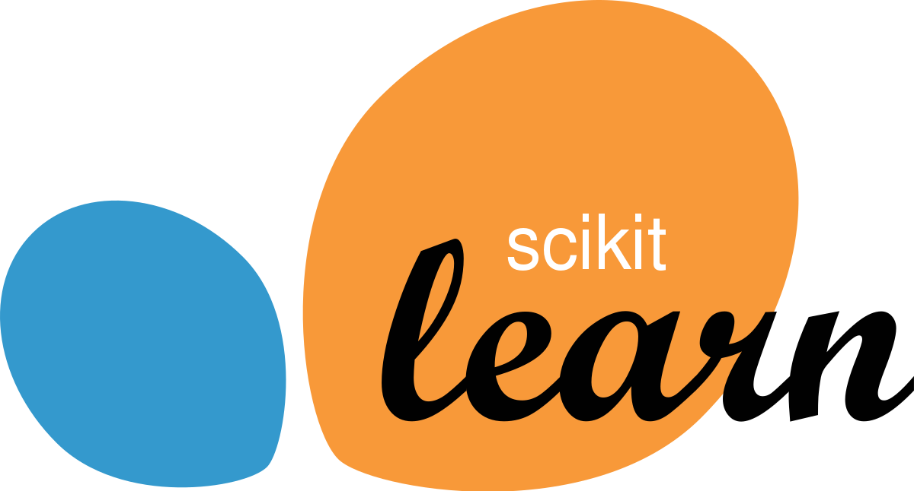
Model Building + Parameter optimization
Problem: what family of models work better with this data?
Solution: model building + parameter optimization

Slide 8
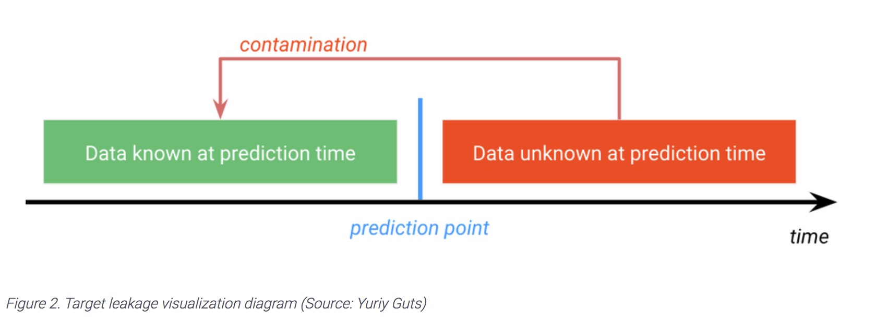
Data Leakage
Image source: https://community.datarobot.com/t5/blog/what-is-target-leakage-and-how-do-i-avoid-it/ba-p/1973
A few killer features have been showing leakage so don't drop that id too soon!

Slide 9
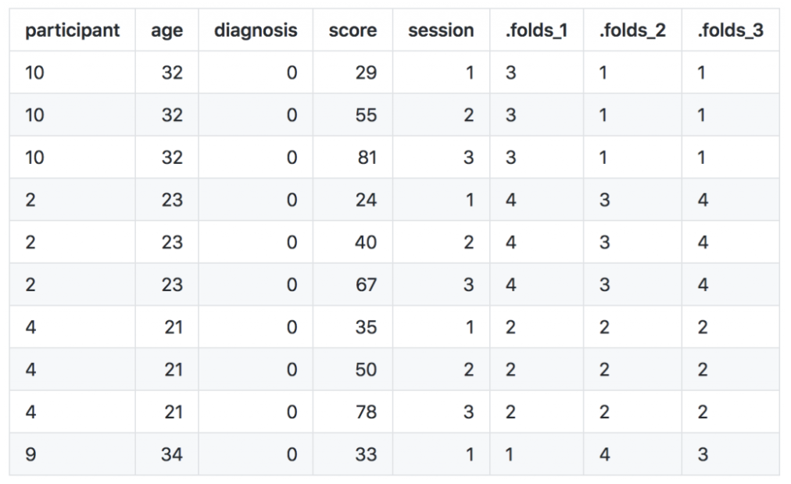
Cross validation - leakage

Slide 10
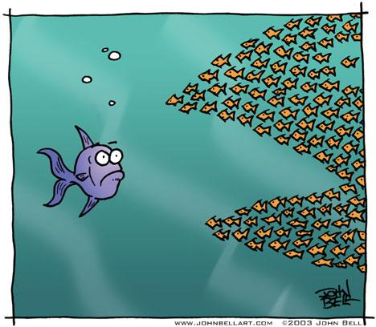
Ensemble
The premise is that a group of weak models is better than one strong model.
The idea is to promote diversity
Changing the training data (e.g., different models using different data)[
Changing the attribute set (e.g., different models use different attributes)
Different algorithms
Changing the parameters of the algorithms
Each individual model makes a contribution. Individual weaknesses and biases are offset by the strength of the numbers
...

Slide 11
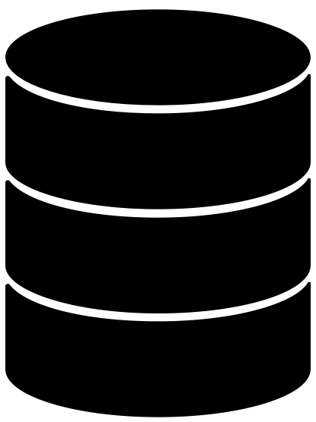
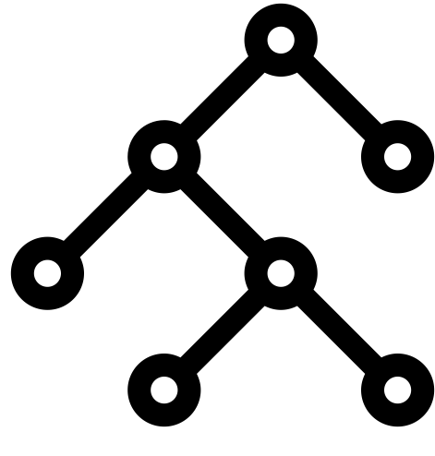

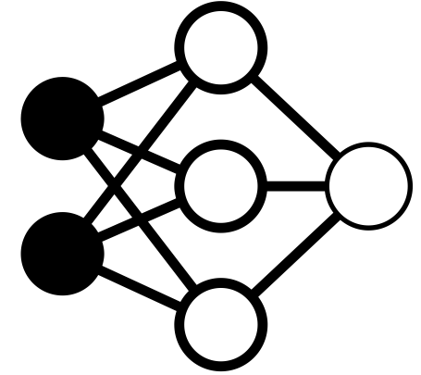
Ensemble: voting
Data
Model
P(‘true’) = 0.7
P(‘true’) = 0.4
P(‘true’) = 0.8
Model output
1
0
1
# True: 2 # False: 1
Count Votes
TRUE
Prediction

Slide 12
Stacking
Stacked generalization (or stacking) is a way of combining multiple models, that introduces the concept of a meta learner.
The predictions, generated by using various machine learning algorithms, are used as inputs in a second-layer learning algorithm. This second-layer algorithm is trained to optimally combine the model predictions to form a new set of predictions.
Output value
Meta-learning algorithm
Base algorithms
Prediction

Slide 13
Stacking Implementation (h2o.ai)
Stacking involves training a second-level “metalearner” to find the optimal combination of the base learners.
Source: http://docs.h2o.ai/h2o/latest-stable/h2o-docs/data-science/stacked-ensembles.html
3 steps:
1. Set up the ensemble
a. Specify a list of L base algorithms (with a specific set of parameters)
b. Specify a metalearning algorithm
2. Train the ensemble
a. Train each of the L base algorithms and collect cross-validated predicted values (“level one” data)
b. Train the metalearning algorithm on the level-one data.
3. Predict on new data

Slide 14
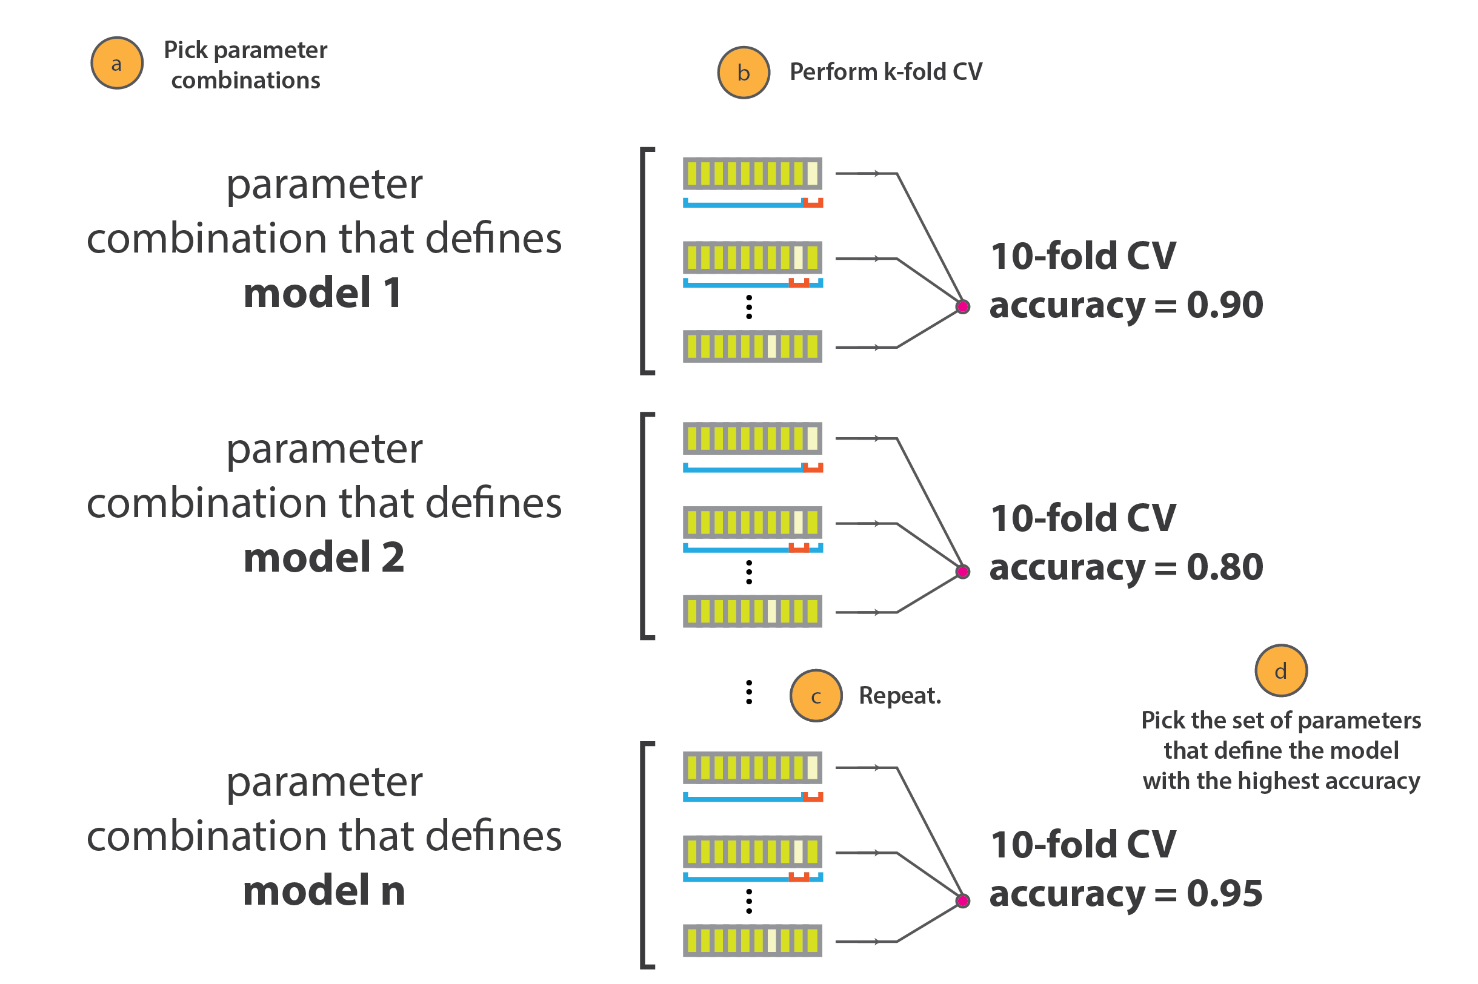
Parameter Optimization
Image source: https://www.kaggle.com/ishivinal/hyperparamters-optimization-gs-rs-boa-tpe-hb-ga

Slide 15
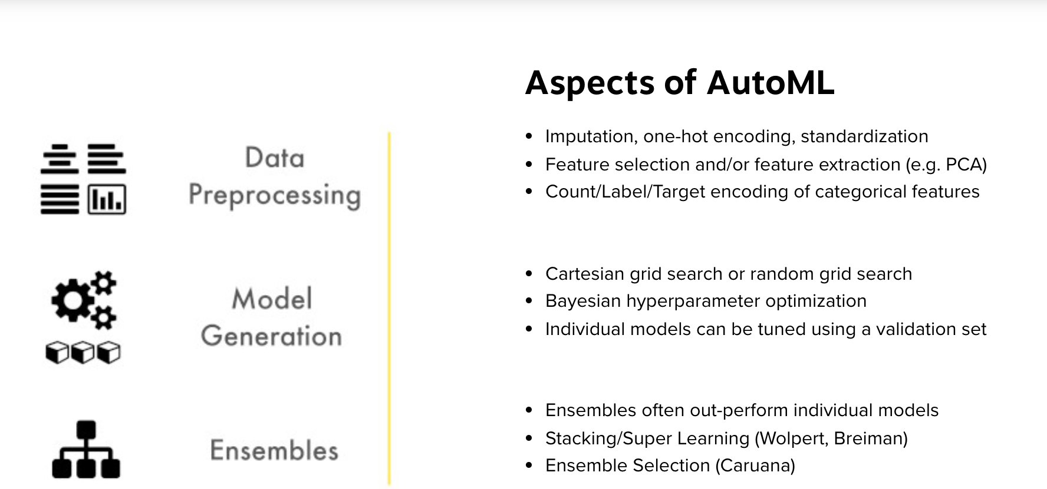
AutoML
Source: https://www.h2o.ai/products/h2o-automl/
https://automl.github.io/auto-sklearn/master/

Slide 16
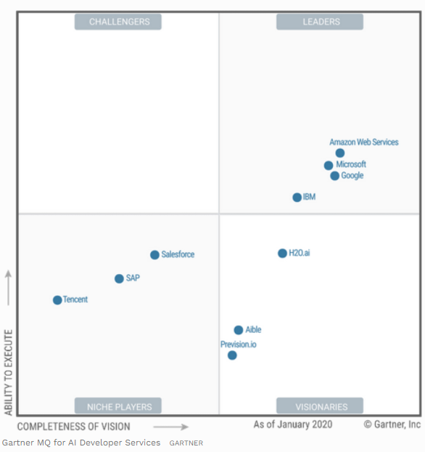
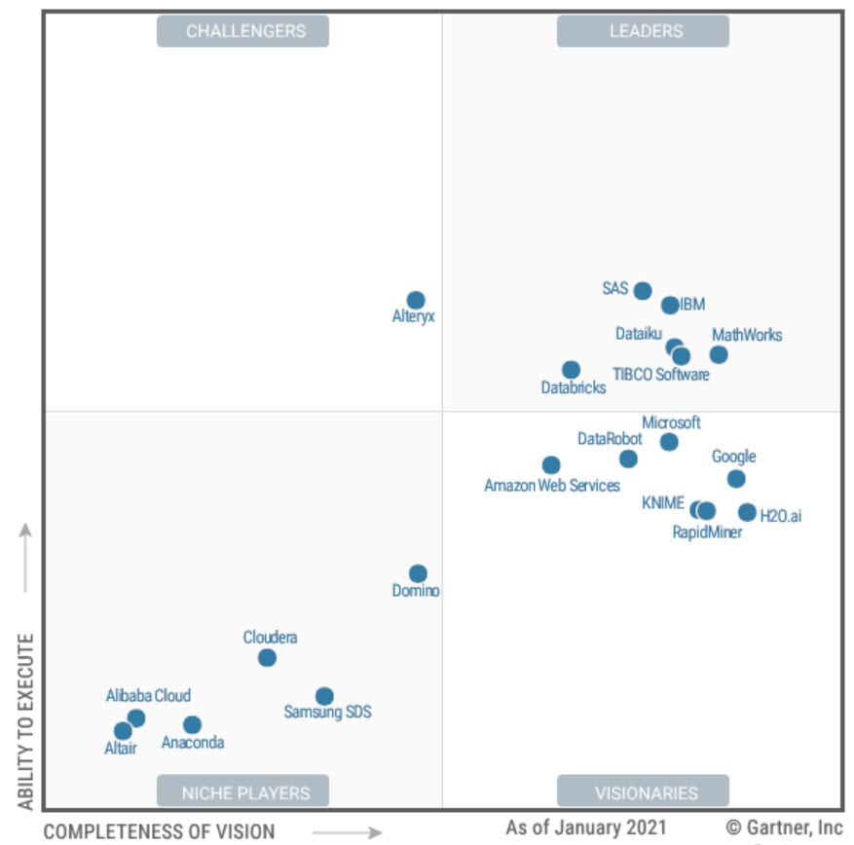
DEMO
H2O Flow
H2O Driverless AI
Data Science and Machine Learning Platforms
AI Services
Source: https://www.forbes.com/sites/janakirammsv/2020/03/02/key-takeaways-from-the-gartner-magic-quadrant-for-ai-developer-services/?sh=7edb9451e3e5

